Slide 1

Los Angeles County
Job Applications

Slide 2
Overview
Introduction
Problem
Objective
Methodology
Data Overview & Cleaning
Data Limitations & Relevance
Findings
Economic Context
Analysis: Industry, Salary, Gender, Race
Recommendations
Suggestions for parity for underrepresented groups
Los Angeles County
Job Applications
(FY 2013-2015)

Slide 3
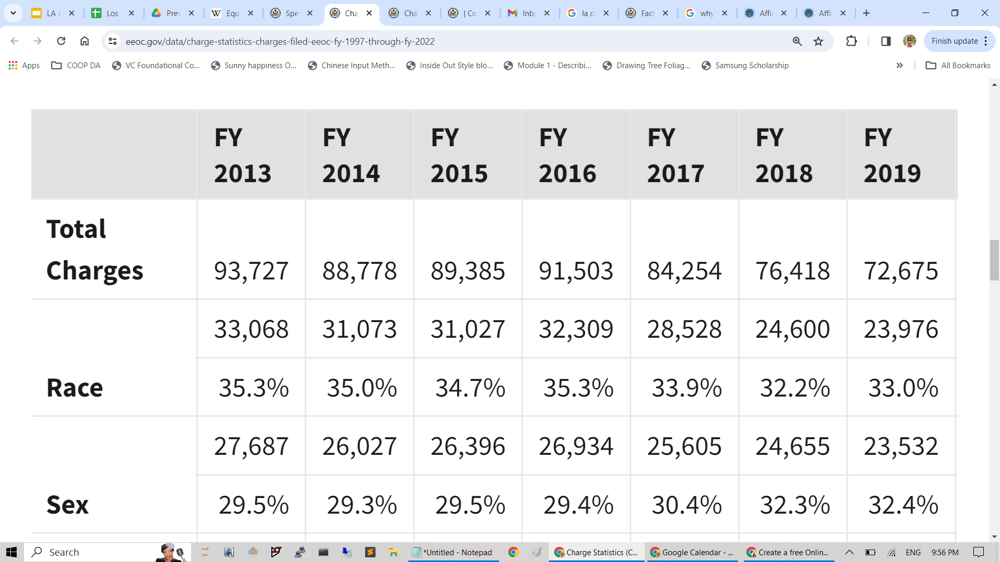
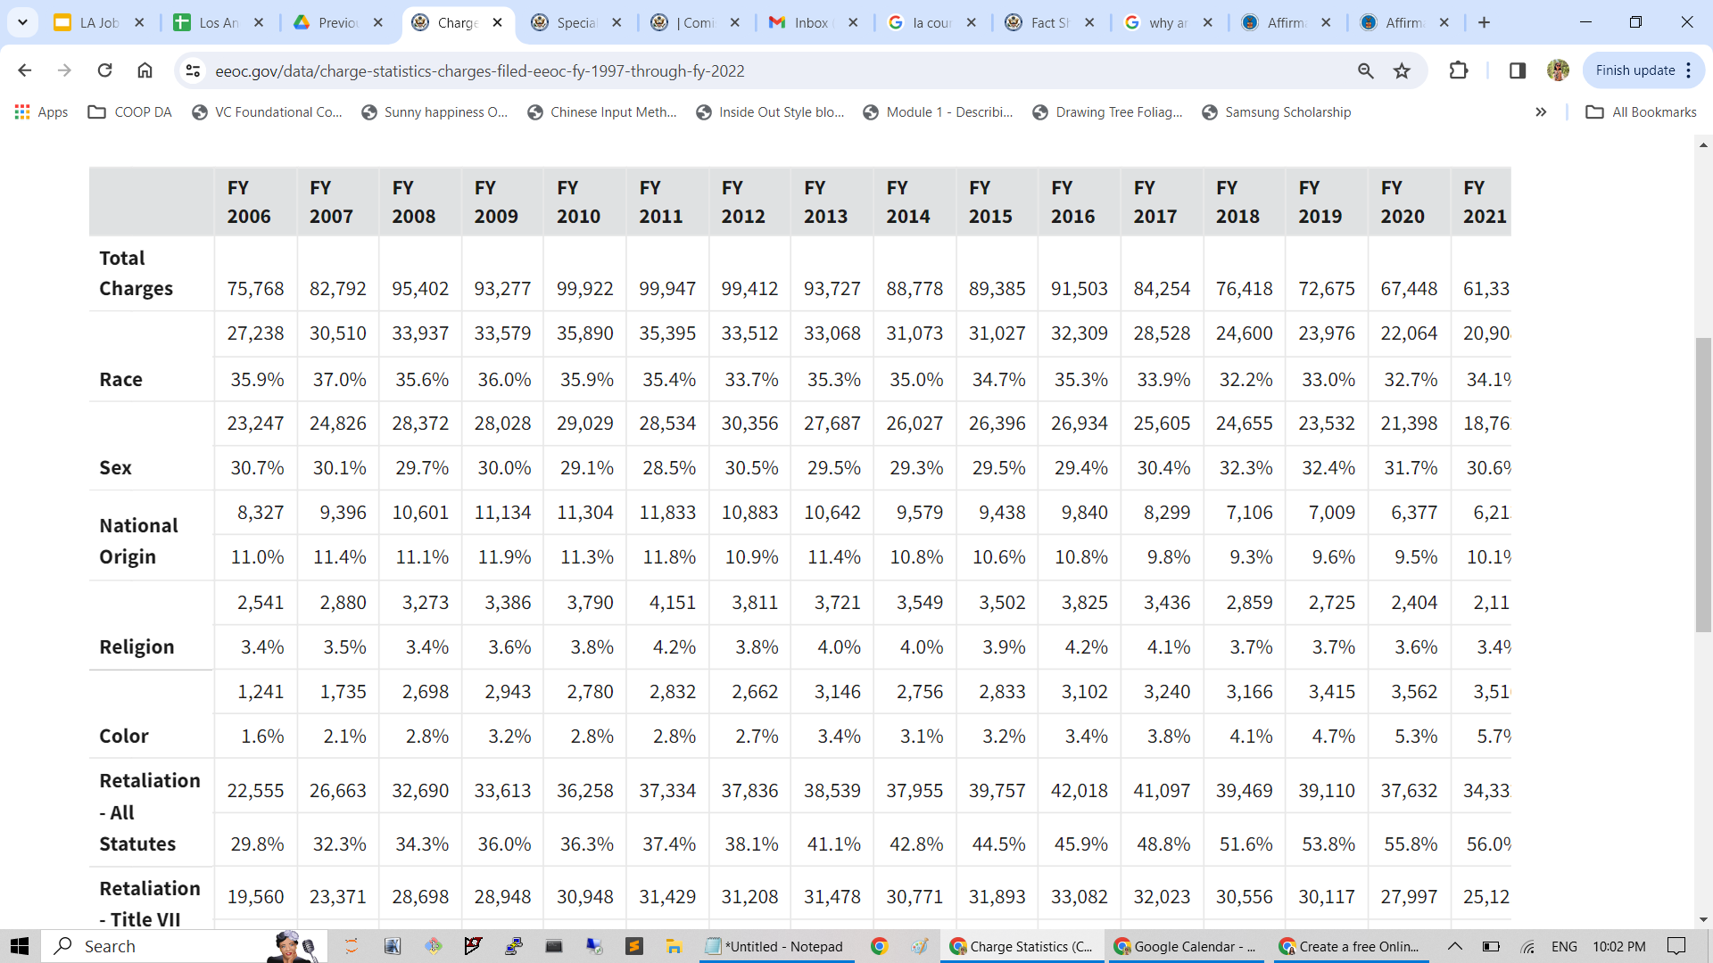
Problem Statement
As a government entity, Los Angeles County is affirmative action employer, which means:
ALL applicants and employees will experience equal employment opportunity
Race, color, religion, sex, national origin, disability, age, genetic information
Source: https://www.eeoc.gov/data/charge-statistics-charges-filed-eeoc-fy-1997-through-fy-2022

Slide 4

Project Objective
The U.S. Equal Employment Opportunity Commission (EEOC) requests assistance to:
Evaluate this data set on job applications across multiple roles in LA county
Identify potential discrepancies among applicants of a protected class
Support policy changes in the city and state with findings

Slide 5
Methodology

Slide 6
Overview of Data
Job Applicants by Gender and Ethnicity publicly available on data.lacity.org
What’s in this Dataset?
187 Rows, 14 Columns
Data created on October 10, 2014
Last updated on November 30, 2020
Source: https://data.lacity.org/Administration-Finance/Job-Applicants-by-Gender-and-Ethnicity/mkf9-fagf/about_data

Slide 7
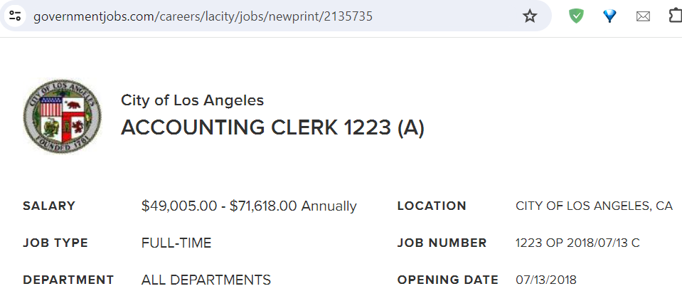
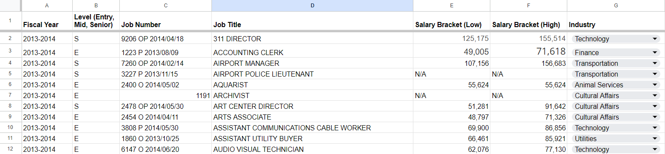
Data Cleaning
Job Titles
Job Description renamed
Numbers and extraneous text removed
Combined duplicate postings
Categorized data for a more detailed analysis
Level, Industry, Salary Brackets columns added
Salary Brackets extracted via Archived Job Listings

Slide 8
Data Limitations
Sample Size
The small size of our datasets hinders its reliability
Lack of variety in jobs
Limits our view of the job market
Lack of information about headcount
Number of available positions for each job requisition
Two-year timeframe
Unable to observe long-term trends and patterns

Slide 9
Relevance
The analysis conducted will provide insights on race and gender disparities present within the LA County job postings for the 2013-2014 and 2014-2015 fiscal years.
Policies from interested groups, such as the EEOC, can gain value from the findings of our analysis, using them to address and reduce disparities related to race and gender.

Slide 10
Data Analysis

Slide 11
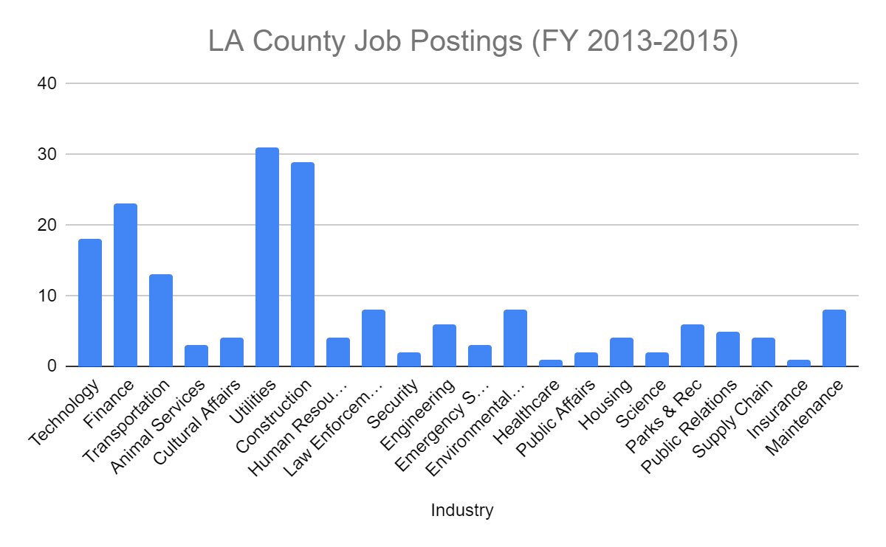
Economic Context
10.5% ==> 7.2%
LA County
High unemployment rates
NROU = 4.6%
Expansionary fiscal policy
Government investment in public infrastructure
Utilities
Construction
Finance
Technology
Transportation
Unemployment Rate

Slide 12
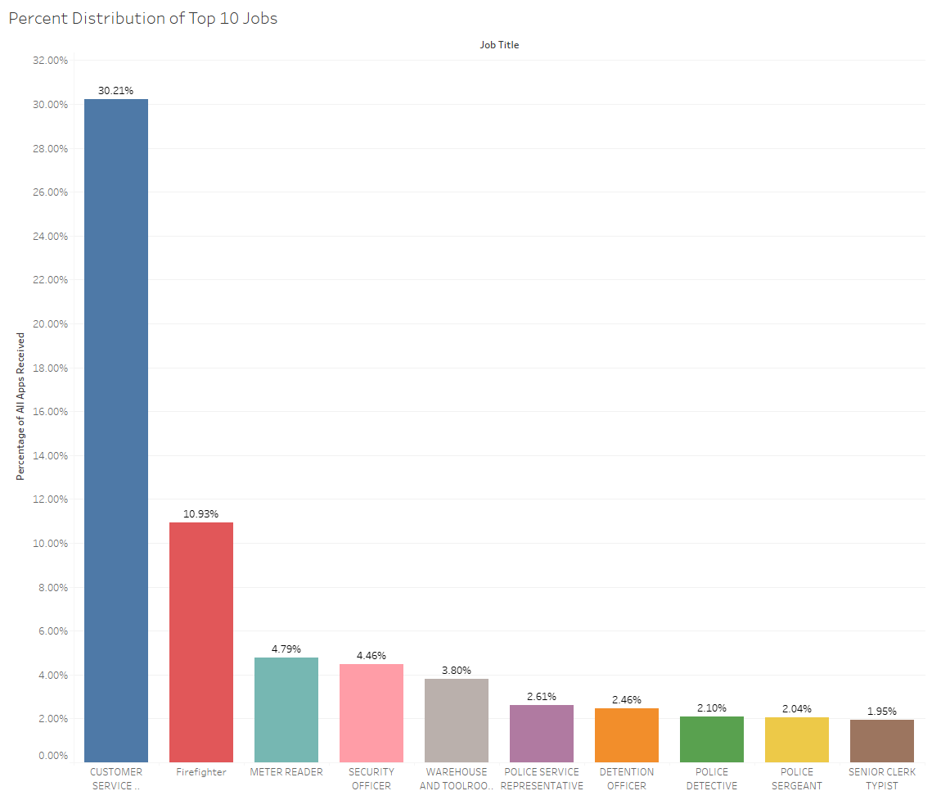
Industry Overview
Customer Service Representatives make up 30.21% of all applicants
Followed up by Firefighters, 10.93%

Slide 13
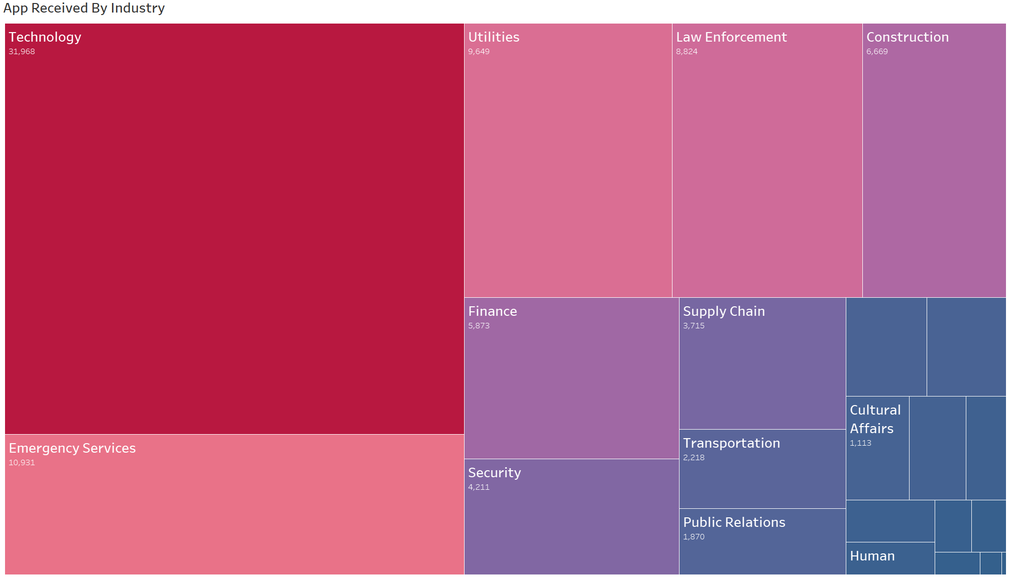
Industry Analysis
Top 8 Industries by number of applicants:
Technology
Emergency Services
Utilities
Law Enforcement
Construction
Finance
Security
Supply Chain

Slide 14
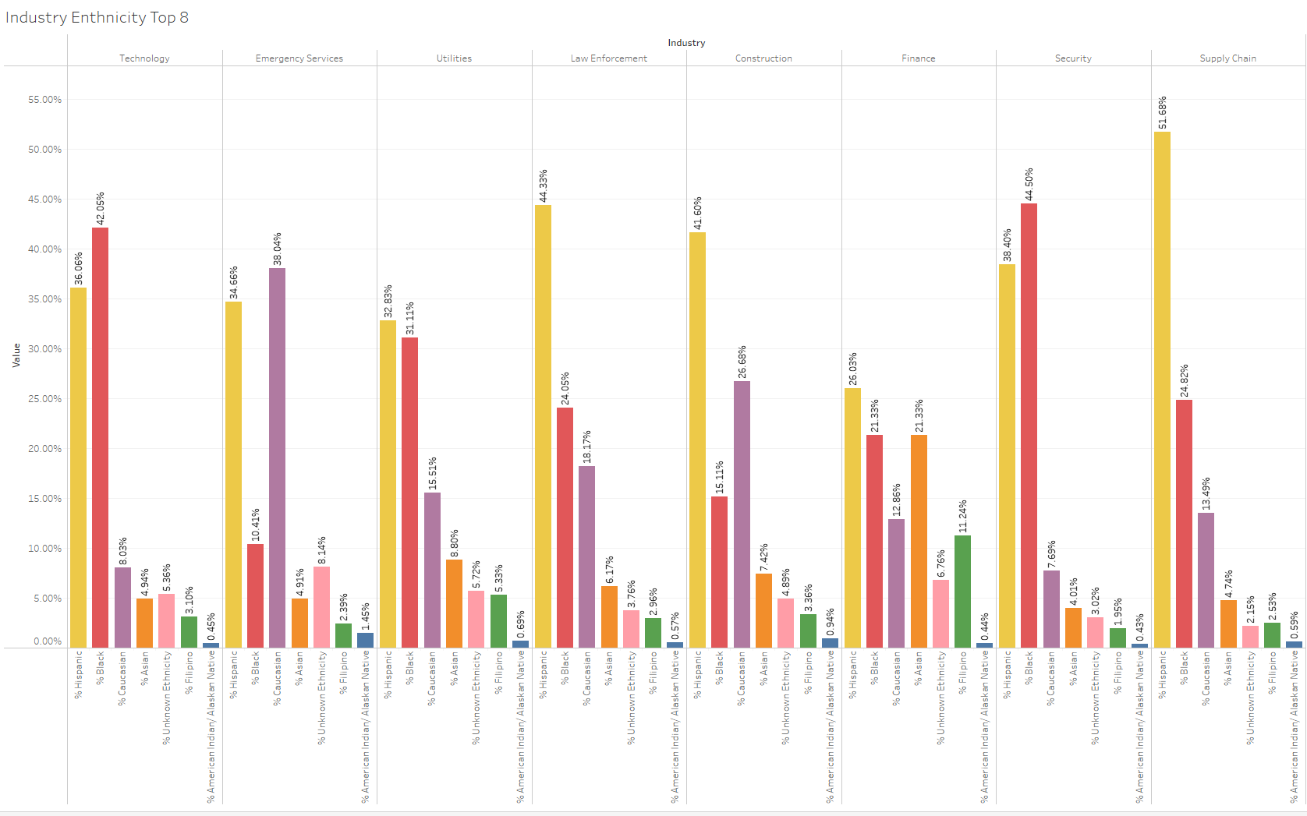
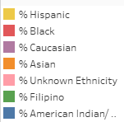
Industry/Race Analysis
Race Percentages Across Top 8 Industries
Hispanic & Black made up 78% of Technology applicants
Hispanic applicants were consistent across Top 8 Industries
Caucasians made up 38% of Emergency Service applicants
American Indians made up the lowest percent of applicants

Slide 15
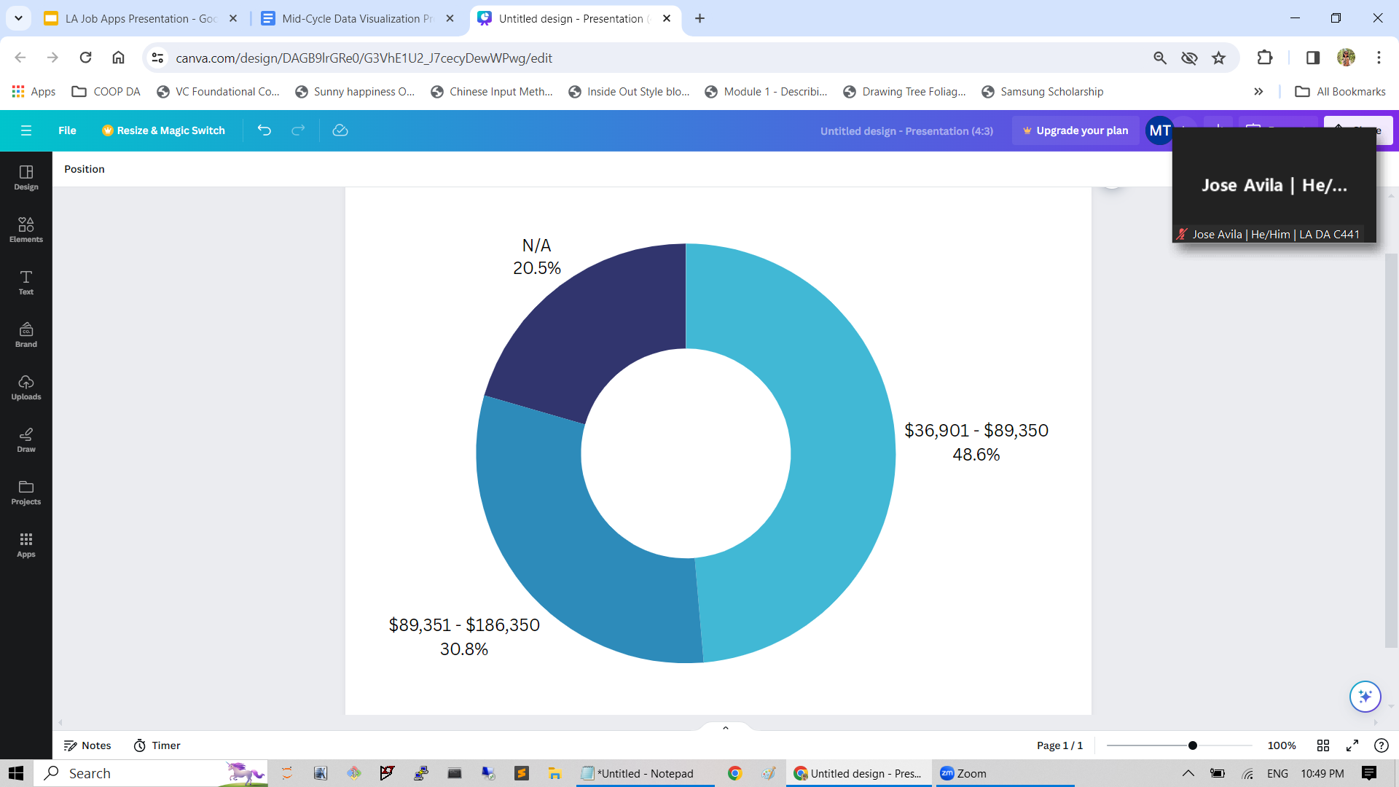
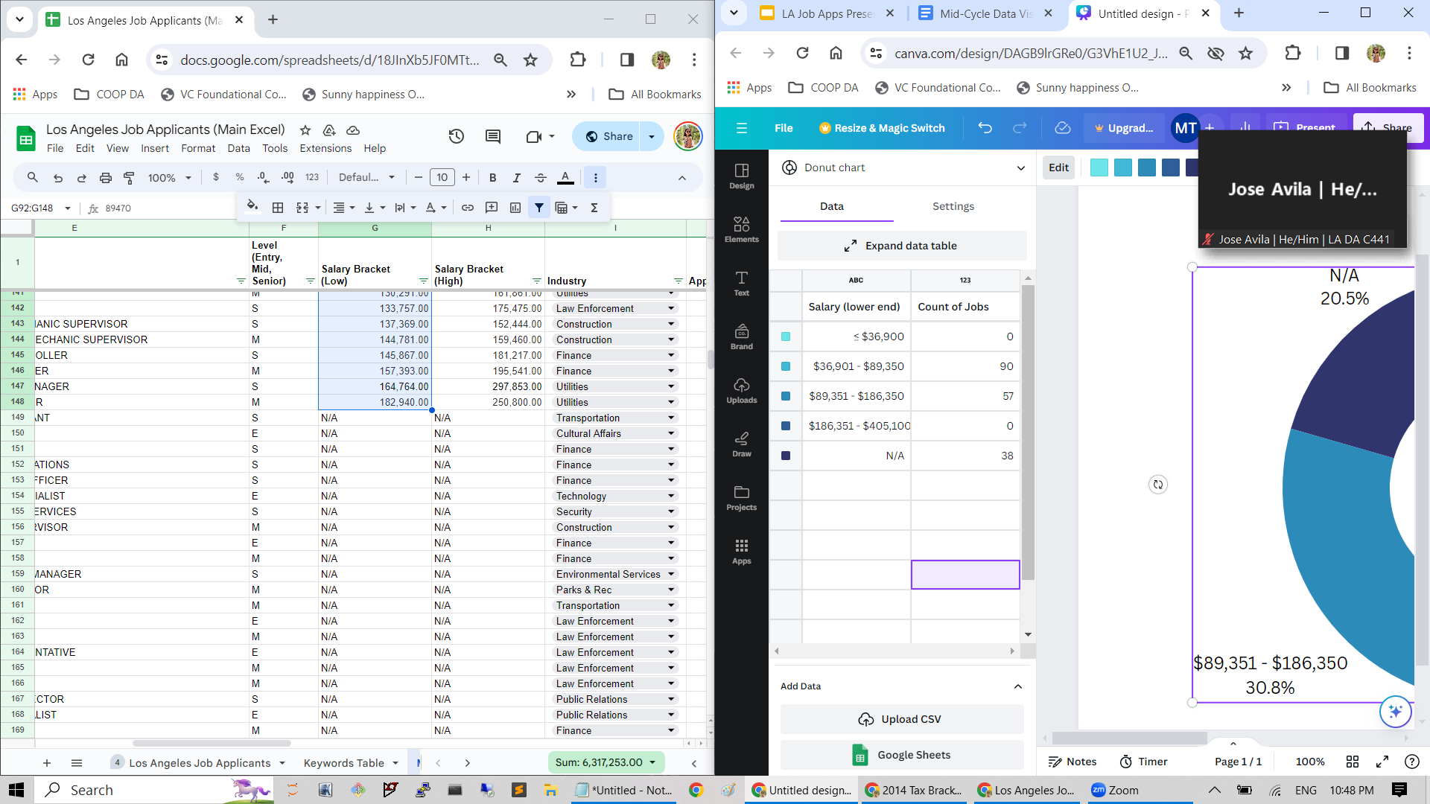
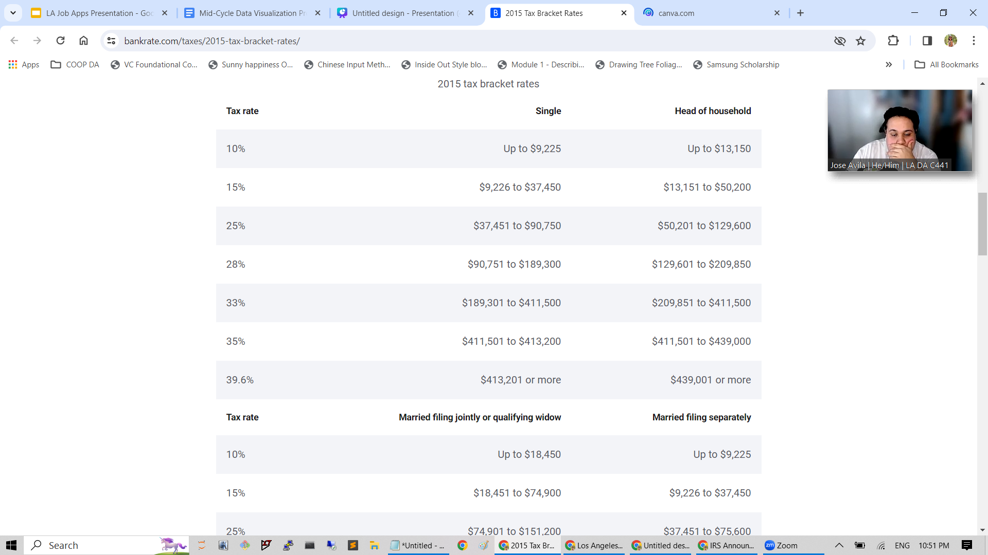
Salary Overview
Salary Distribution
Among Open Job Requisitions†
100% | of jobs fall within the 15-25% tax bracket^
93,448 | applicants
19.5% | of jobs lack salary range*
^within available salary ranges * note incomplete data offers limited insight † LA County Job Applications

Slide 16
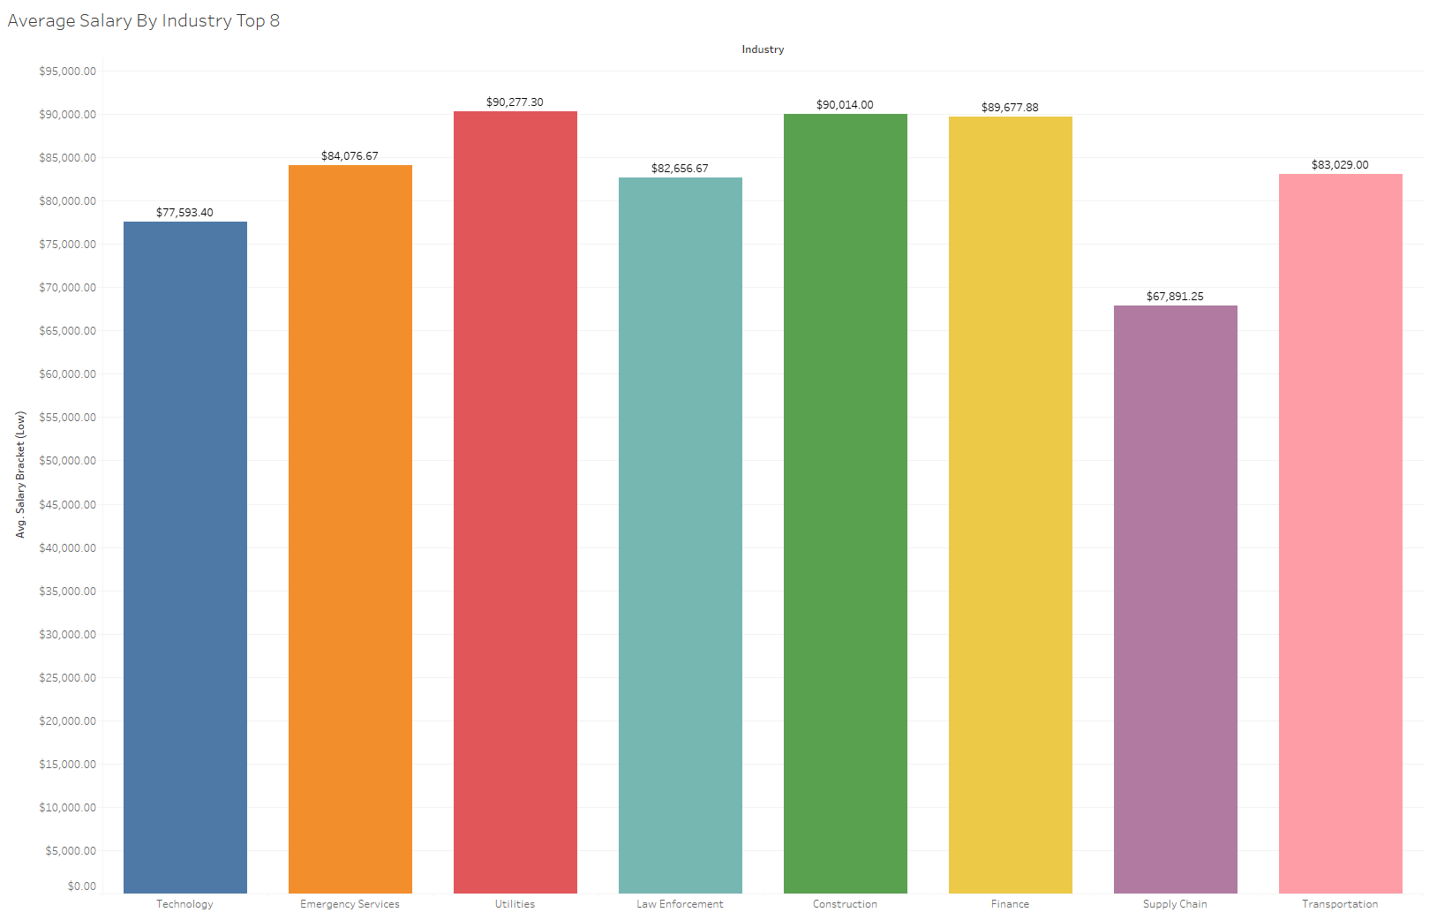
Salary Analysis
Top 8 Industries by # of applicants on x-axis
Industries with the highest average starting salary:
Utilities
Construction
Finance
Emergency Services
Transportation
Law Enforcement
Technology
Supply Chain

Slide 17
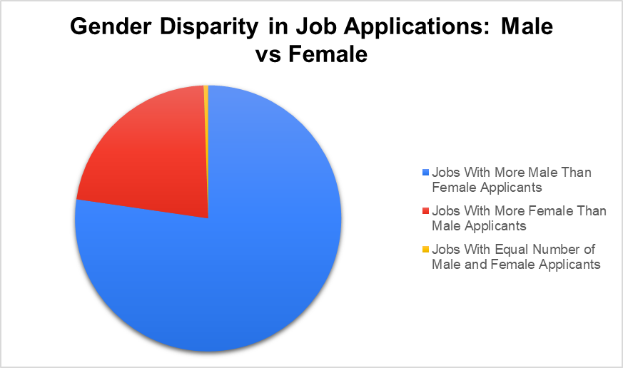
Gender Analysis
77% of jobs have more male than female applicants
22% of jobs have more female than male applicants
.5% have an equal number of applicants
Average Disparity: 67%

Slide 18
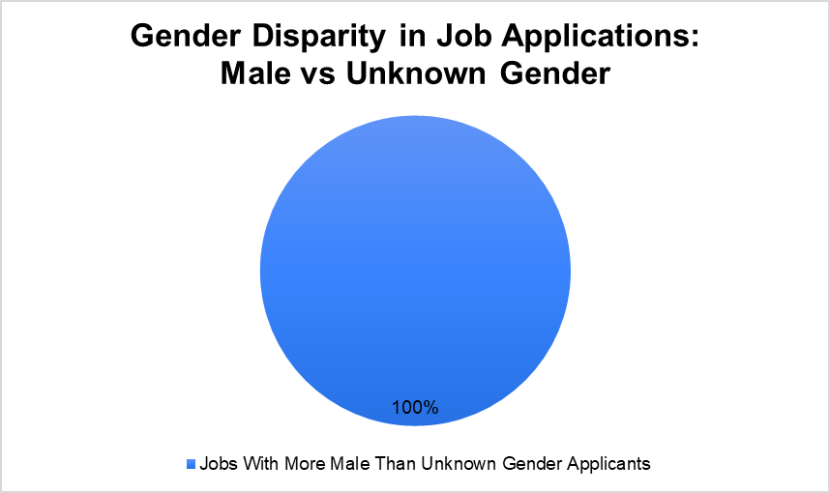
Gender Analysis
100% of jobs have more male than unknown gender applicants
Average Disparity: 69%

Slide 19
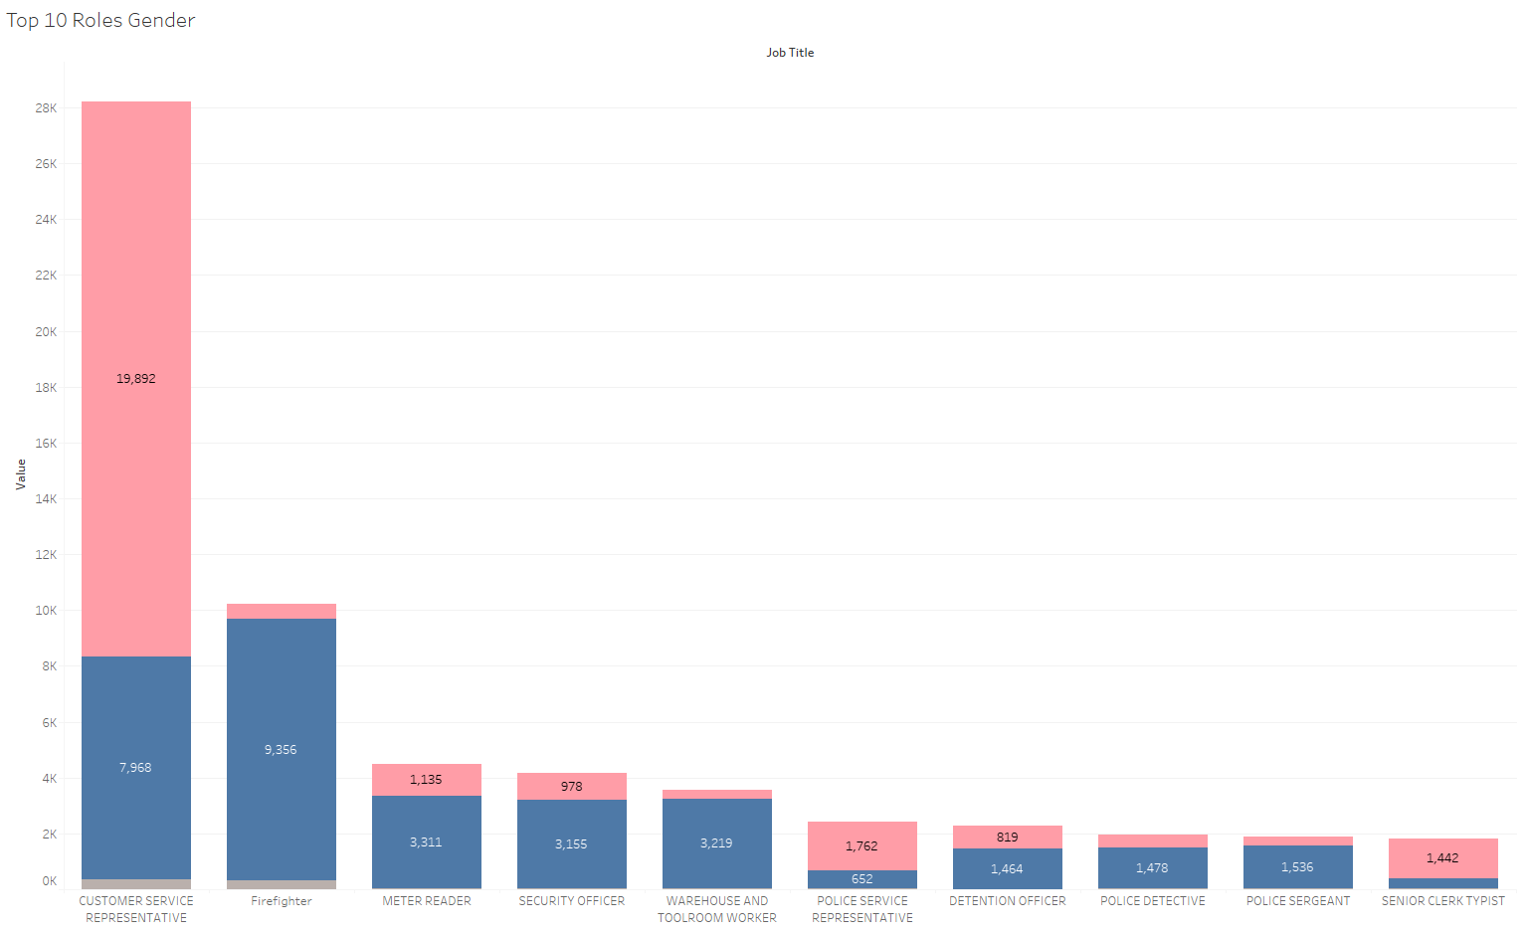
Gender Analysis
Gender breakdown of the Top 10 Roles by number of applicants

Slide 20
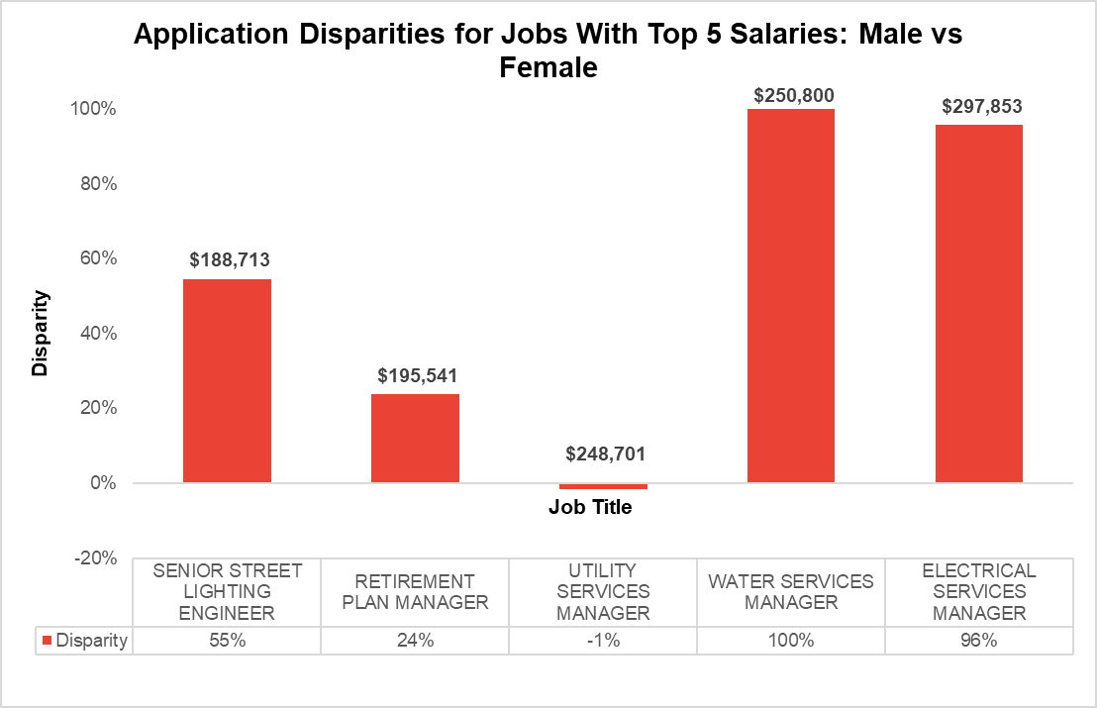
Gender Analysis
Males lead in job applications considerably
Third highest salary has an ideal disparity

Slide 21
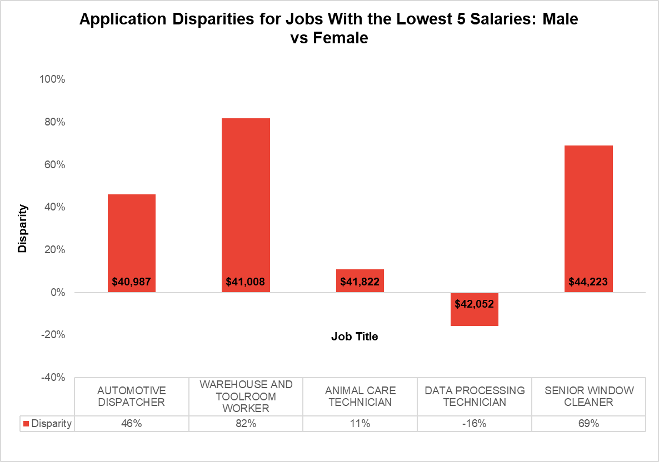
Gender Analysis
Males continue to lead in job applications
Third & fourth lowest salaries have ideal disparities

Slide 22
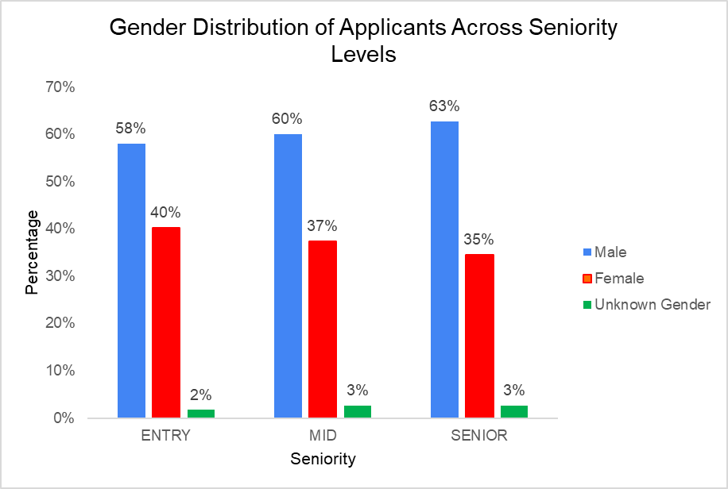
Gender Analysis
Male and Female Disparities: 18% (Entry), 23% (Mid), and 28% (Senior)
Male and unknown gender applicants disparities: 56% (Entry), 57% (Mid), and 60% (Senior)

Slide 23
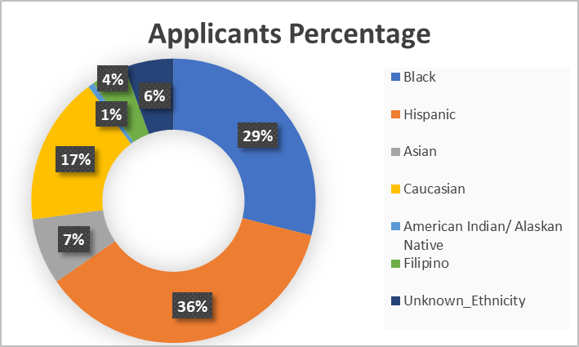
Race Overview

Slide 24
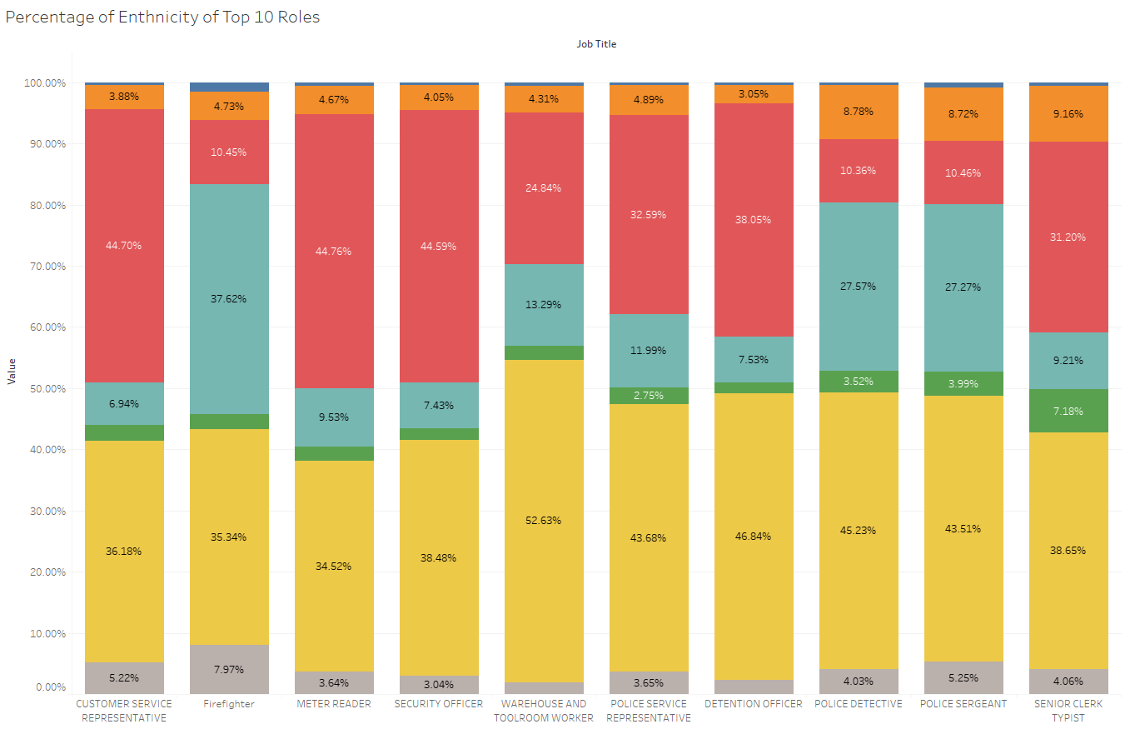
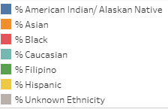
Race Analysis
Ethnicity breakdown of the Top 10 Roles by number of applicants

Slide 25
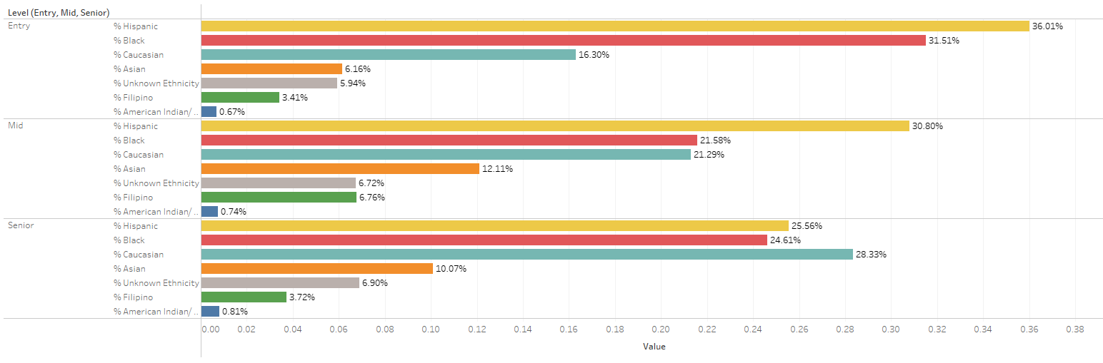
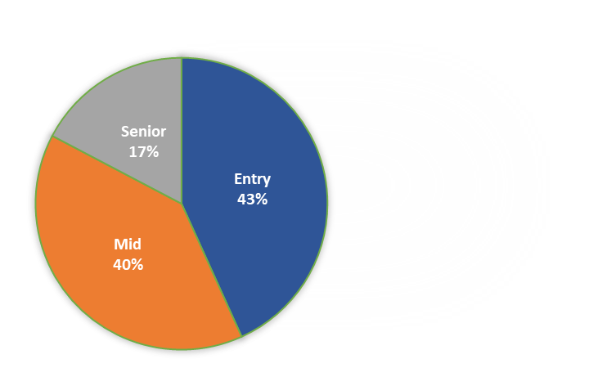
Race/Seniority Analysis
Racial Breakdown of Applicants to Jobs Grouped by Seniority
Job Level / Seniority
Entry
Mid
Senior

Slide 26
Recommendations

Slide 27
Recommendations
Increase outreach efforts to underrepresented groups through educational community workshops
To ensure that they are aware of their rights and how to file a complaint with the EEOC if they experience discrimination
Provide bias training for LA County recruitment team
Annual Zoom sessions to promote engagement and participation to keep up with fair hiring practices
Features case studies and role-playing exercises
Disaggregate EEOC data to identify disparities within ethnicities and identify strategic priorities given resource constraints
Refugee groups: Afghan, Burmese, Somalian, Venezuelan, etc.
https://public.tableau.com/app/profile/tom.pham5473/viz/LAJobApplicantsDashboard/Dashboard12

Slide 28
Thank you!
Any questions?

